Slide 1
PROJECT 3
CLASSIFICATION OF VOLE SKULLS
WITH GLM
Group 4
Sai Ram Vodnala
Carlos Quevedo Garza
Kevin Osei-Onomah
Soniya Shahi
November 2024

Slide 2






Introduction
Data Overview
Table of Contents
Exploratory Data Analysis (EDA)
Model Development and Evaluation
Predictions

Slide 3
Introduction
Problem
Objectives
Goals
Identification of 199 unidentified voles
To classify the 199 unidentified voles into either subterraneus or multiplex voles.
Build separate models for the skulls that only have a subset of the features.

Slide 4

Data Overview
The dataset consists of 288 skull measurements from two species, with 89 specimens classified through chromosomal analysis. The remaining 199 specimens are unclassified. Data Cleaning
3 sheets of data
First sheet (Unknown)
Skipped row between index 20 and 21
Hidden Row 8
Second sheet (Subterraneus)
Skipped row between index 13 and 15
Third sheet (Multiplex)
Skipped row
Duplicate data between index 30th and 31st row.
Note: Changed Column names and converted to CSV.

Slide 5
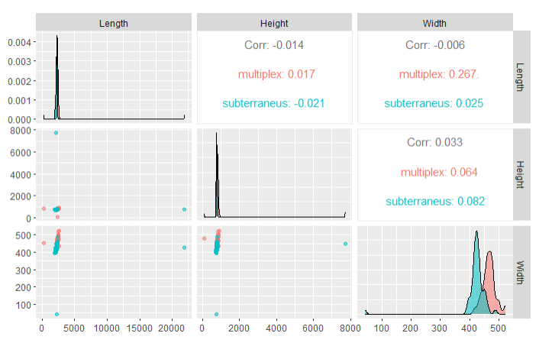
Exploratory Data Analysis- Outliers
Figure: With Outliers

Slide 6
Exploratory Data Analysis- Outliers
Outlier Handling
There were a total of 8 extreme values (Outliers).
We used IQR method and replaced outliers with the median values
Fixed outliers one by one to handle each species correctly.
Made sure we manage outliers correctly so that they won’t mess up our modeling work.

Slide 7
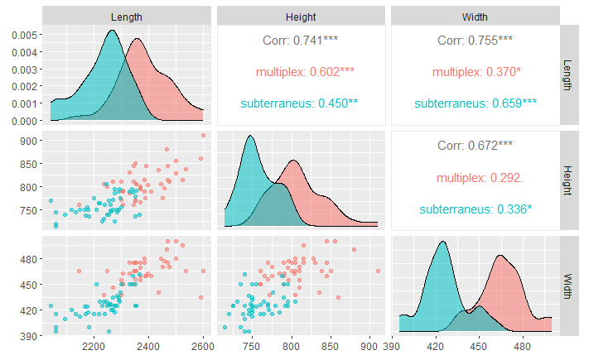
Exploratory Data Analysis- Outliers
Figure: After Handling Outliers

Slide 8
Model Development and Evaluation
Consolidated the labeled datasets for subterraneus and multiplex voles
Employed Ten-fold cross-validation
The final training and validation accuracies were obtained by taking the mean of the accuracies across the Ten iterations
Developed seven models, each representing a distinct combination of the three features (Length, Width, and Height)

Slide 9
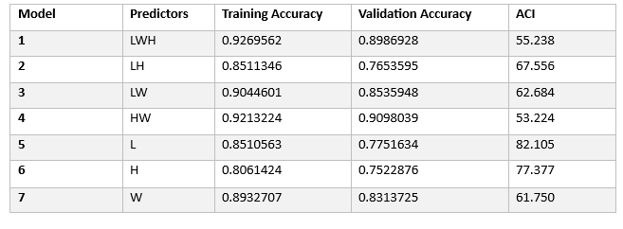
Model Development and Evaluation
Training Results

Slide 10
Predictions
We used our models to classify the unknown data.
For records with missing fields, we used the corresponding model.
We also classified all the unknown skulls according to the corresponding model.
Prioritizing the HEIGHT AND WIDTH model classified we got
83 as subterraneus and116 as multiplex.

Slide 11
Thank You!!!.

